Slide 1


Presented By : The Assembly Team

Slide 2
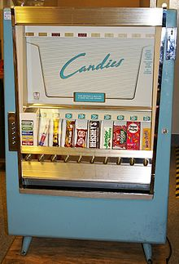
A little background
A vending machine is an automated machine that provides items such as snacks and beverages to consumers after money, a credit card, or specially designed card is inserted into the machine.
The first modern vending machines were developed in England in the early 1880s and dispensed postcards

Slide 3
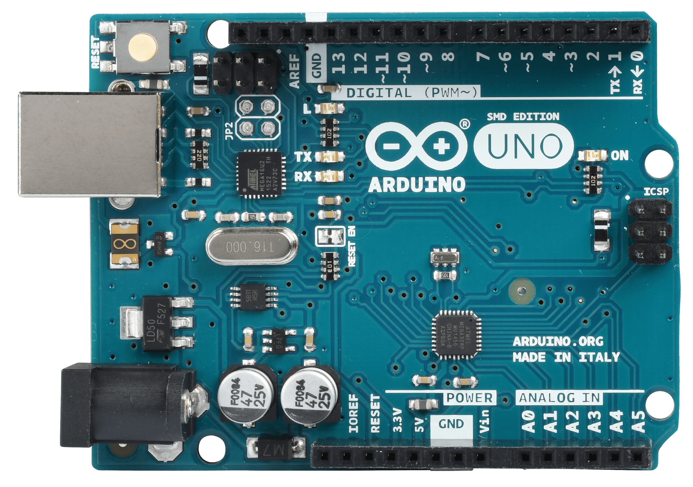
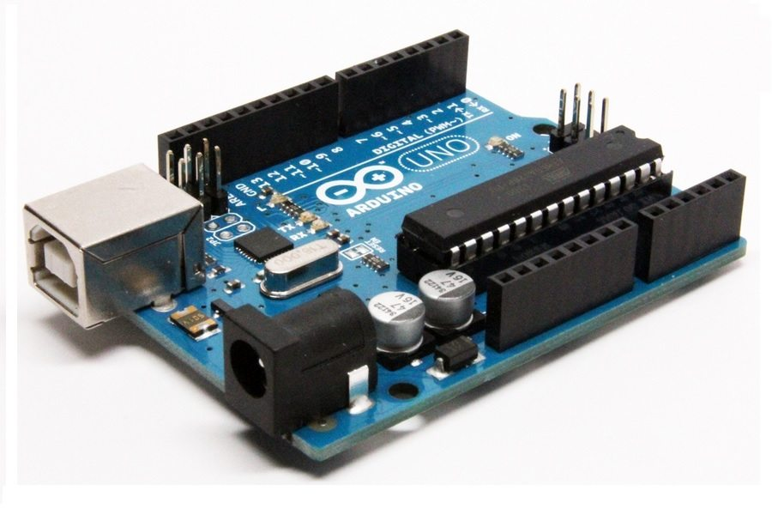
Arduino UNO
Notes:
The Arduino Nano is a small, complete, and breadboard-friendly board based microcontroller
Nano has two extra analog pins
Good replacement for uno as it is breadboard friendly

Slide 4
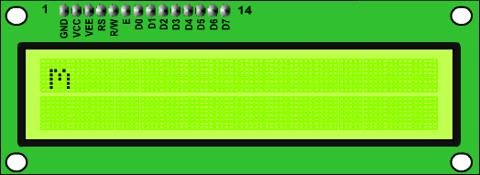
Liquid Crystal Display

Slide 5
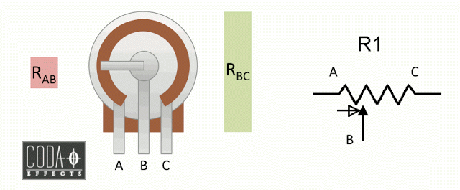
Potentiometer

Slide 6
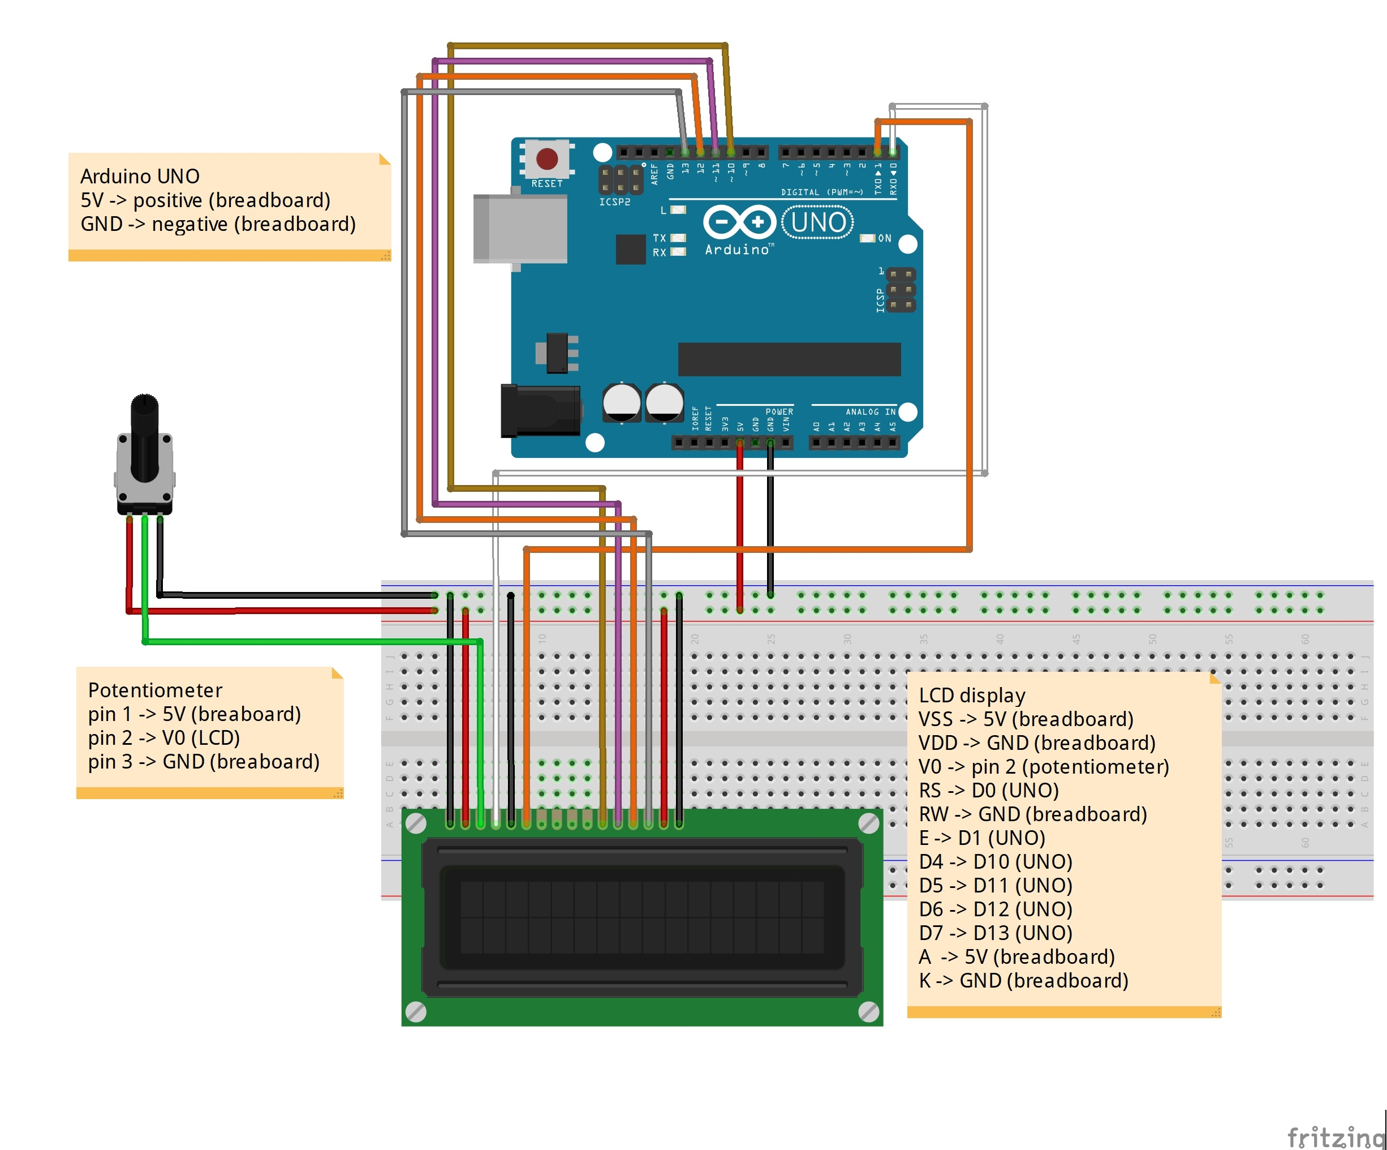

Slide 7
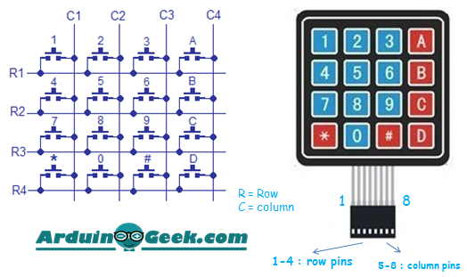
Keypad

Slide 8
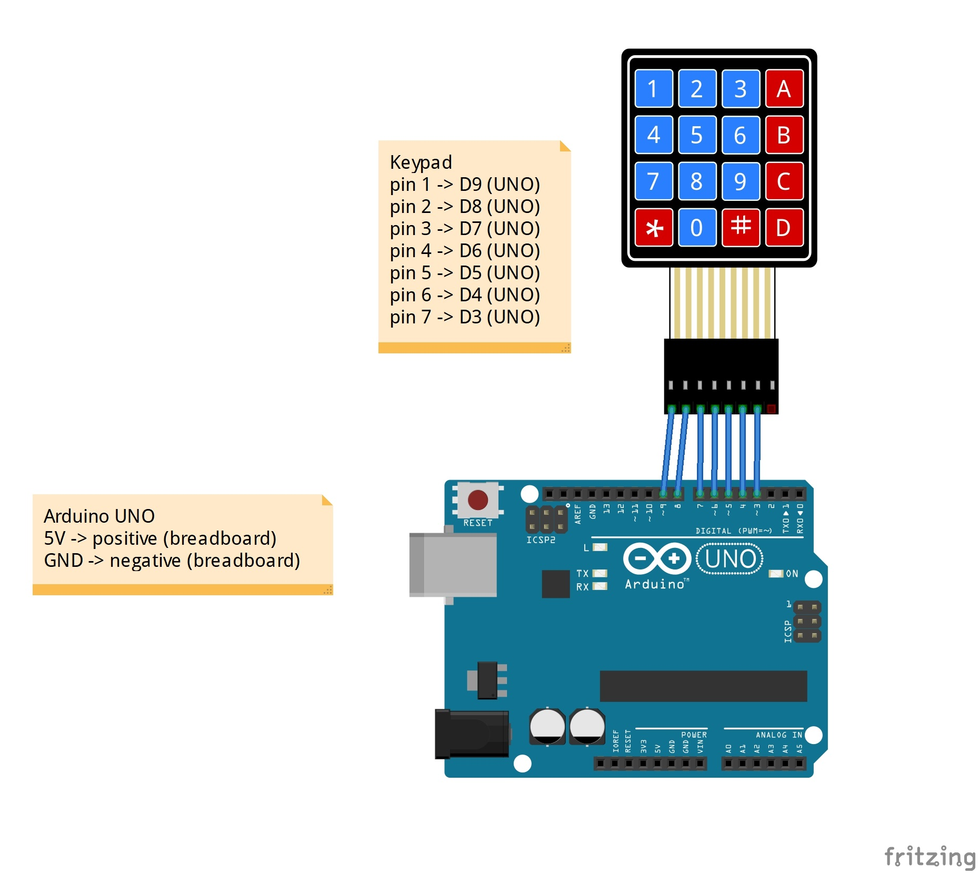

Slide 9
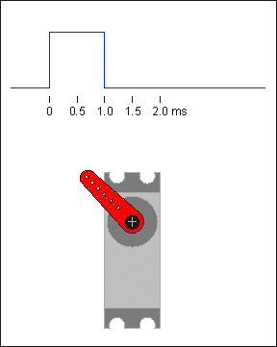
Servo motor
Push or rotate an object with great precision
PWM (Pulse width modulation)
Speed vs torque control
Fast, high torque, accurate rotation within a limited angle,
Suited for toy car, RC helicopters and planes, Robotics, Machine, etc..

Slide 10
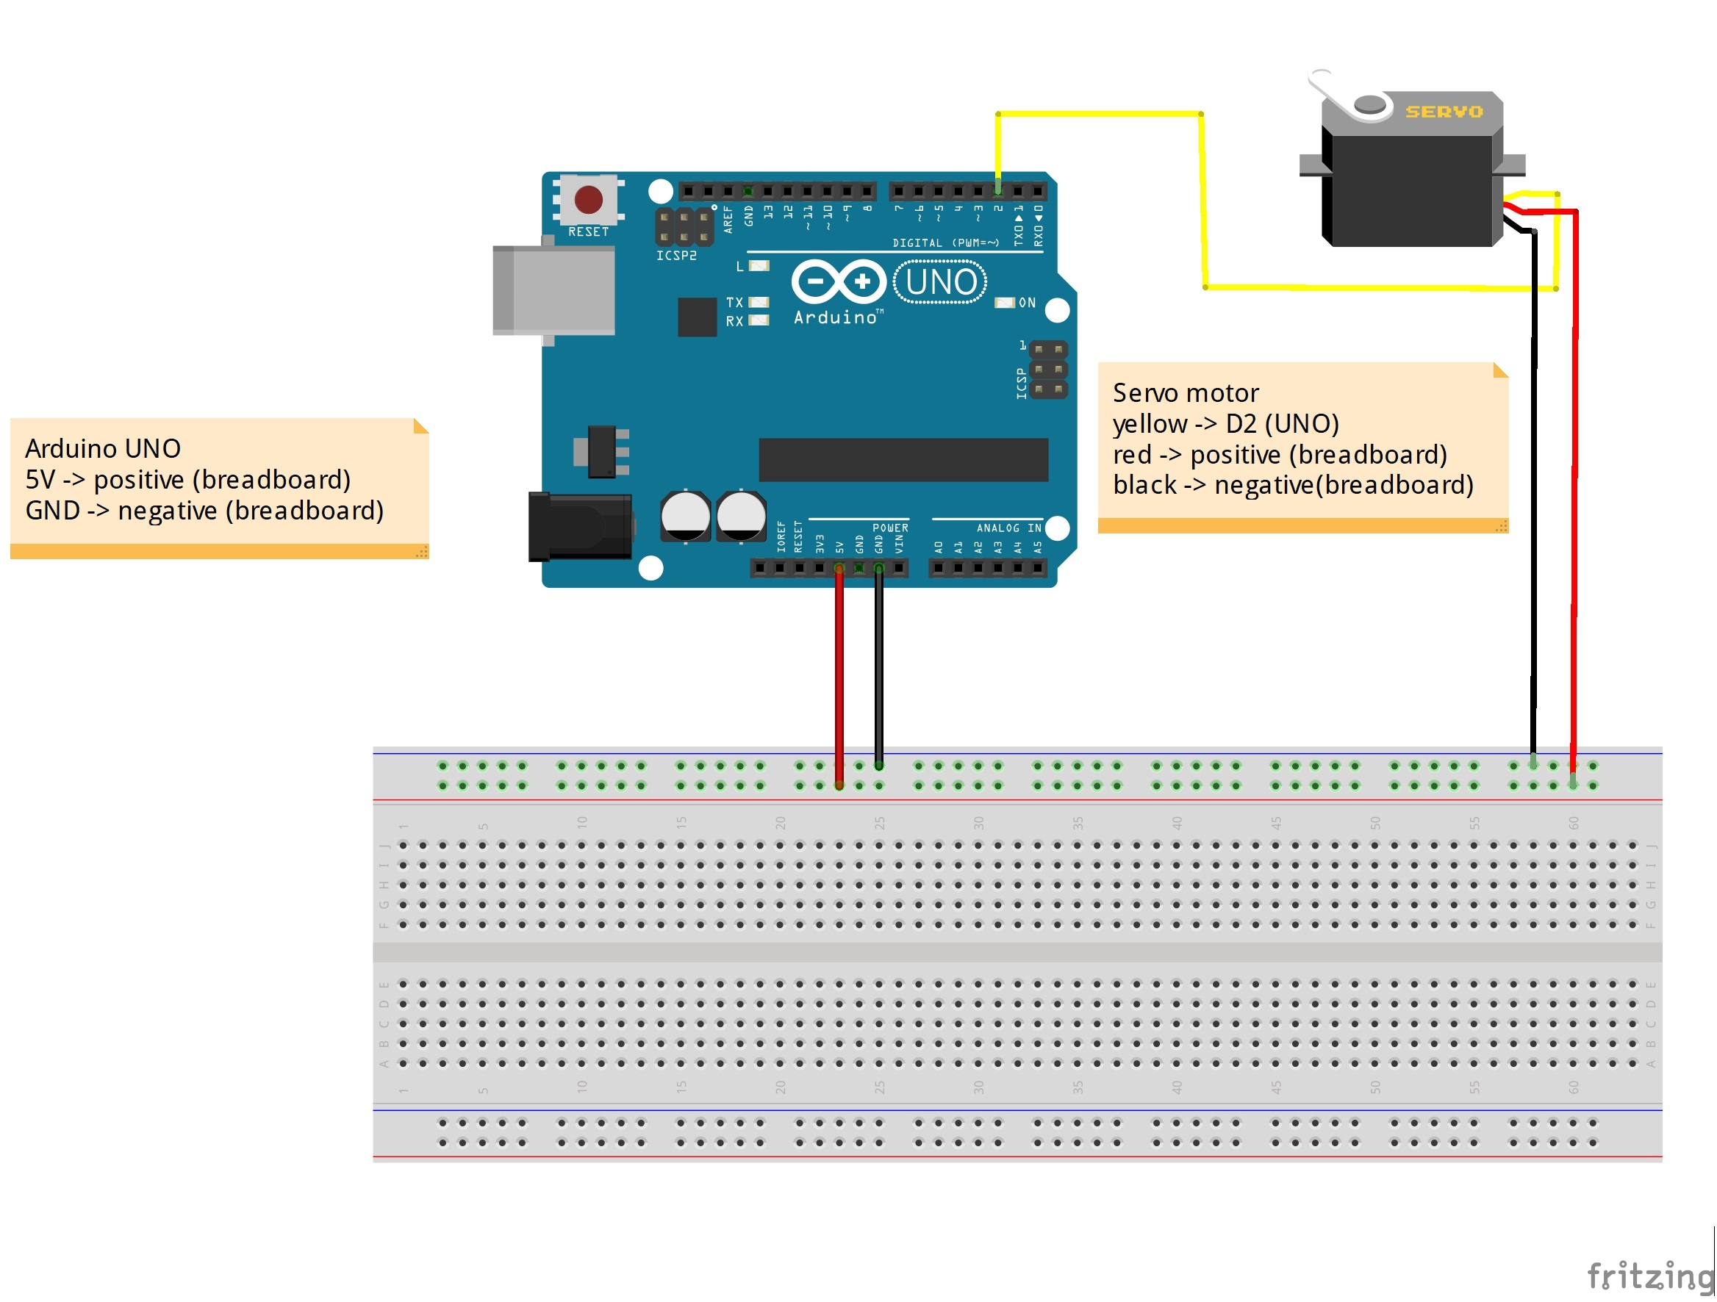

Slide 11
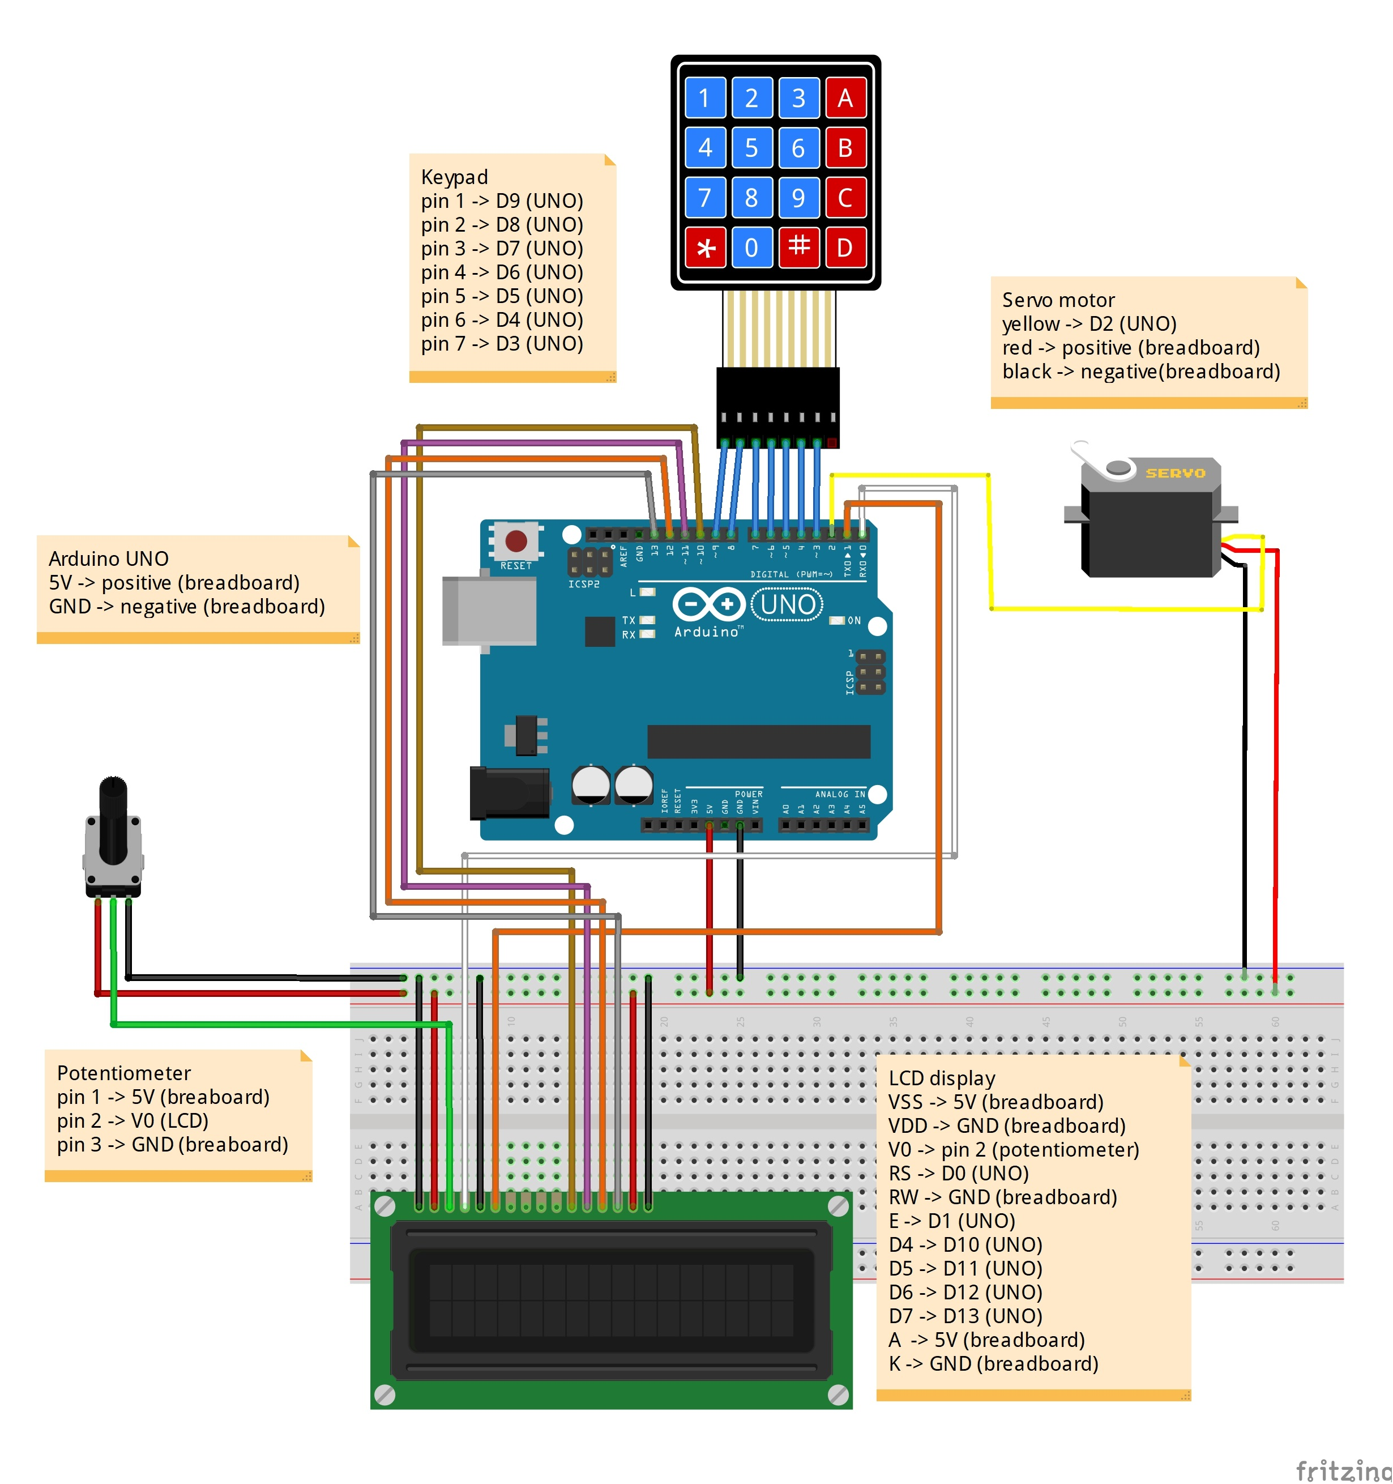
Entire circuit

Slide 12
Github Link
https://www.github.com/The-Assembly/candy_dispenser

Slide 13

THANK YOU

